Slide 1
Introduction to Machine Learning
Chunyang Wei

Slide 2
Chunyang Wei
Recommendation Team
chunyang.wei@hulu.com

Slide 3
Introductin to Machine Learning
Lecture 1: Overview of Machine Learning & Linear regression
Lecture 2: Linear classification - Logistic Regression & SVM
Lecture 3: Non-linear classification – Decision Tree, Random Forest, Neural Network
Lecture 4: Clustering – K-means, Mixture Gaussian
Lecture 5: Topic Model – PLSA, LDA
Lecture 6: Other topics - model combination & recall & other common model
Notes:
KNN??
NN??

Slide 4
Lecture 1: Overview of Machine Learning

Slide 5
Today’s Outline
Definition and Application of machine Learning
Categories of machine learning
A typical procedure of machine learning
Linear regression

Slide 6
What is Machine Learning
“Machine Learning is a field of study that gives computers the ability to learn without being explicitly programmed” - Arthur Samuel (1959)
Machine learning is a set of methods that can automatically detect patterns in data, and then use the uncovered patterns to predict future data, or to perform other kinds of decision making under uncertainty. – Machine Learning: A Probabilistic Perspective

Slide 7
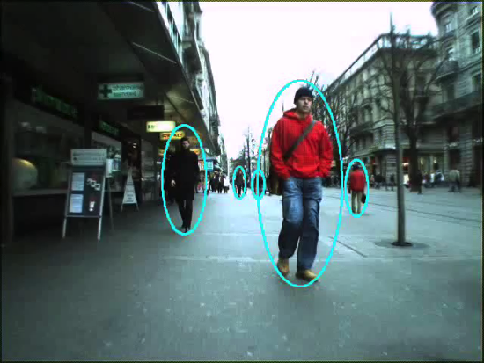

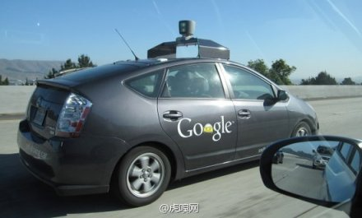




Application of Machine Learning
Notes:
Computer Vision, Speech Recognition, driverless car
NLP, ctr prediction, recommendation, search
医学领域、金融领域、问答系统
,

Slide 8
Categories of Learning problem
Machine Learning
Supervised Learning
Unsupervised Learning
Classification
Regression

Slide 9
Supervised Learning
Definition:
Learn a mapping from inputs to outputs , given a labled input-output pairs
Concepts:
Training set: D (N is the number of training examples)
The i-th sample:
Feaures: is a d-dimensional vector of numbers
Label:
Notes:
D={(\mathbf{x}^{(i)}, y^{(i)})} ~~ i=1…N

Slide 10
supervised Learning
Regression problem
is continuous, real-valued, e.g. price, temperature
Classification problem
is categorical, . e.g. gender
Binary classification:
Multiclass classification: C > 2
Notes:
编辑公式

Slide 11
UnsupErised Learning
Definition
Give only given inputs, , the goal is to find “interesting patterns” in the data
Goals
Clustering: discover groups of similar samples with the data
Density estimation: determine the distribution of data with the input space
Discovering latent factors: reduce the dimensionality by projection the data to a lower dimensional
Abnormal detection: detect abnormal sample in the input data set

Slide 12
Categories of Model
Linear / Non-linear
Linear: Predict function is a linear combination of the model parameters
Non-linear:
Discriminative / Generative
Discriminate: Learn conditional probability p(y|x) directly, or learn a direct mapping from input x to class label y
Generative: Learn joint probability p(x,y), and make their predictions by using Bayes rules to calculate p(y|x) and then picking the most likely label y
Parametric / Nonparametric
Parametric:
Nonparametric:
Notes:
编辑公式

Slide 13
Review our outline
Lecture 1: Overview of Machine Learning & Linear regression
Lecture 2: Linear classification - Logistic Regression & SVM
Lecture 3: Non-linear classification – Decision Tree, Random Forest, kernel SVM
Lecture 4: Clustering – K-means, Mixture Gaussian
Lecture 5: Topic Model – PLSA, LDA
Lecture 6: Other topics - model combination & recall & other common model

Slide 14
A typical procedure of machine learning
Train:
Figure out the problem
Generate dataset
(Determine the label and figure out features )
Train
(Build a model)
Refine the model
Feature selection
Try different models
Model
Test
Predict:
new data
Model
Output value

Slide 15
Common evaluation metric - Binary classification
Accuracy:
(A+D)/(A+B+C+D)
Precision-Recall:
Precision: A/(A+B)
Recall: C/(C+D)
AUC
The area under ROC curve
ROC curve:
x: FP rate = FP/(FP+TN)
y: TP rate = TP/(TP+FN)
Random classification is a line between (0,0) and (1,1)
 | Positive | Negative
Predict positive | A | B
Predict negative | C | D
Notes:
画个ROC曲线的示意图，以及横轴、纵轴是什么

Slide 16


Common evaluation metric - Regression
Mean absolute error (MAE)
Mean square error (MSE)
Notes:
公式编辑

Slide 17
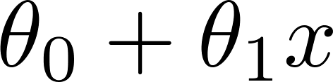
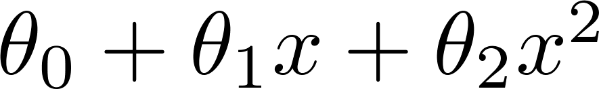
Overfitting problem
If the model is too much complex(have too many parameters), the learned prediction may fit the training set very well, but fail to generalize to new examples
Example: Predict price of the house according to size
Price
Price
Price
Size
Size
Size

Slide 18
Overfitting problem
We need to separate training set and testing set

Slide 19
Cross Validation
Simple methodology:
Use 70% data as training set
Use 30% of the data as hold out validation set
Pick the model perform best on the validation set and retrain on the whole data set.
Drawbacks: waste of 30% the data
K-fold cross validation
Random split training dataset into k subsets. S₁, S₂, …, S_{k}
For j = 1…k
Train the model on S-S_{j}
Test the model on S_{j}
Use avg(error(S_{j})) as the final metric
Pick the best model and retrain on the whole data set.
Notes:
画图

Slide 20
Overcome overfitting
Enlarge the training set
Regularization
Restrict parameter space to control model complexity
Notes:
Insert a picture

Slide 21
Linear Regression

Slide 22
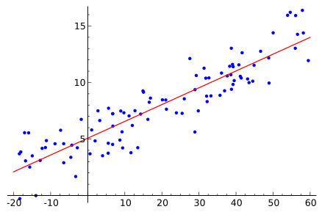
A simple Example
Simple example of linear regression with chart (one variable)
Supervised, Regression

Slide 23
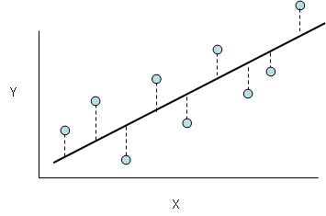
Build the model
Least mean squares:
Goal:
Hypothesis
Strategy
Optimization algorithm
Model
Gradient Descent
Notes:
画图示意：
Hypothesis，直线
Strategy：最小二乘法，预测到实际的距离
Optimization:梯度下降法
y&=f(\mathbf{x}) \\
&=\mathbf{\theta^T }\mathbf{x} \\
&=\sum_{i=1}^{D}\theta_ix_i+\theta_0
J(\theta)=\frac{1}{2}\sum_{i=1}^{N}(f(\mathbf{x}^{(i)})-y^{(i)})^2
\arg\min_\theta{J(\theta)}

Slide 24
Cost function
Least Mean Squares
Another view of LMS

Slide 25
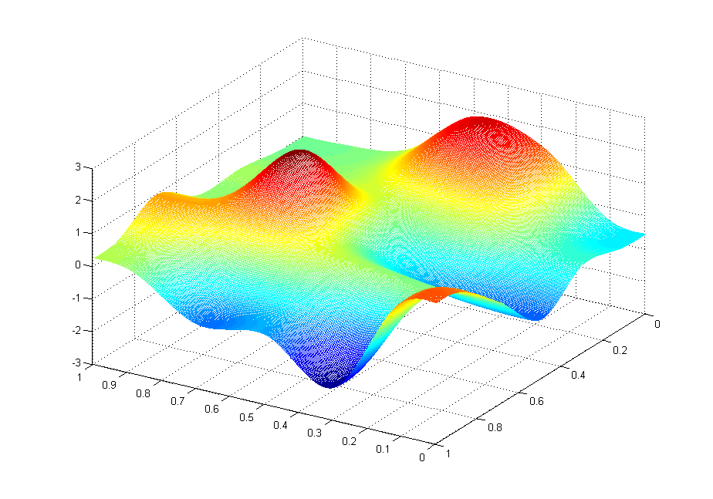
Gradient Descend
Goal:
Main idea
Start with some
Keep changing to reduce until we hopefully end up at a minimum
J(θ₀,θ₁)
θ₁
θ₀

Slide 26
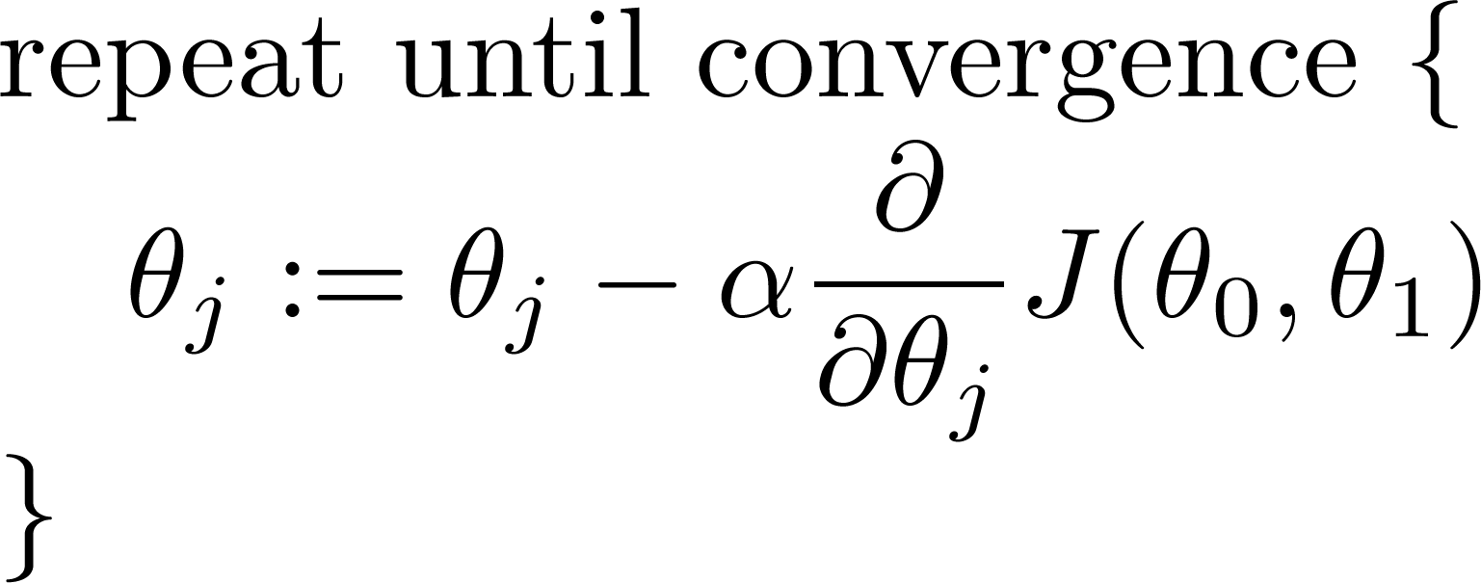
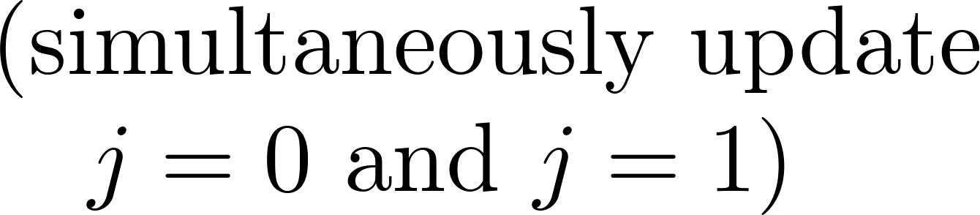
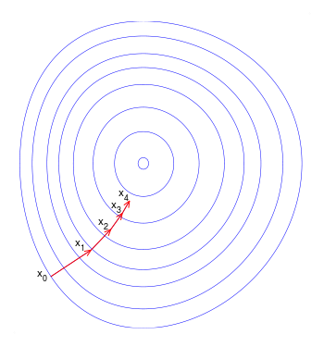
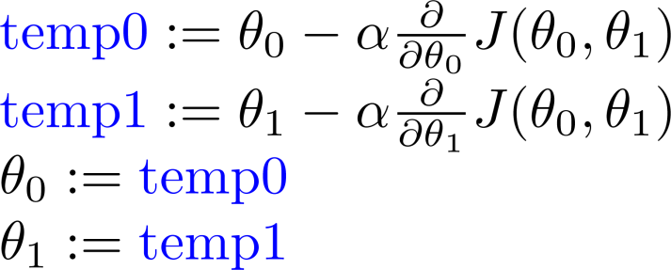
Gradient Descend Algorithm
learning rate
derivative
Simultaneously update:
Notes:
画图（抛物线）示意梯度下降过程，以及α太大太小的示例

Slide 27
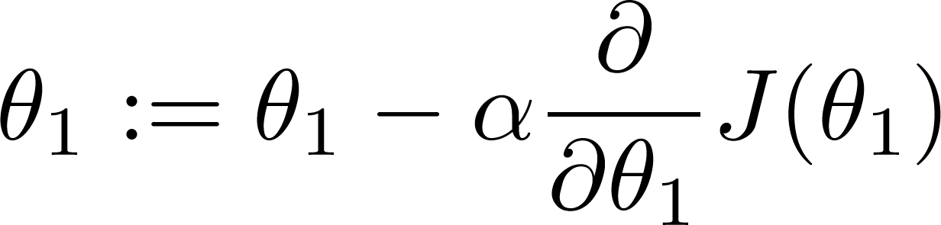
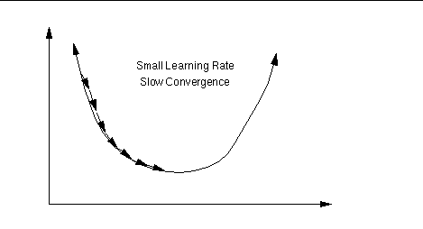
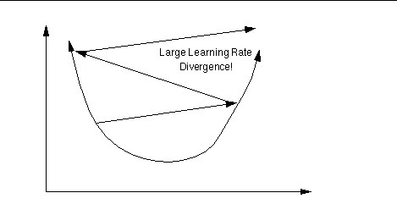
About Learning Rate
If is too small, gradient descent can be slow.
If is too large, gradient descent can overshoot the minimum. It may fail to converge, or even diverge.

Slide 28
local optima Issue
J(θ₀,θ₁)
θ₁
θ₀

Slide 29
local optima Issue
J(θ₀,θ₁)
θ₁
θ₀

Slide 30
Linear Regression Inference
is a convex function, so it don’t suffer the local minimum problem
Intuition:
Update according to the error
Notes:
&\frac{\partial J(\theta)}{\partial \theta_j}\\
&=\frac{\partial }{\partial \theta_j} \frac{1}{2}(f_{\theta}(\mathbf{x})-y)^2\\
&=(f_{\theta}(\mathbf{x})-y)\frac{\partial}{\partial\theta_j}(f_{\theta}(\mathbf{x})-y) \\
&=(f_{\theta}(\mathbf{x})-y)\frac{\partial}{\partial\theta_j}(\sum_{i=0}^d{\theta_i{x_i}}-y) \\
&=(f_{\theta}(\mathbf{x})-y)x_j

Slide 31
Batch vs. Stochastic
Batch gradient descent
- use all the data in one iteration
Stochastic gradient descent
- use one sample per iteration
Can convergent to global optima
Slowly for each iteration, especially when N is large
Convergent faster
May not reach the global optima
In practice, always use SGD, and decrease α gradually
Notes:
&Repeat~until~convergence~ \{\\
&~~~~~~~~\theta_j:= \theta_j + \alpha \sum_{i=1}^N{(y^{(i)}-f_\theta(x^{(i)})x_j^{(i)}} \\
&\}
&Repeat~until~convergence~ \{\\
&\qquad for~i=1…N ~\{ \\
&\qquad\qquad \theta_j:= \theta_j + \alpha (y^{(i)}-f_\theta(x^{(i)})x_j^{(i)} \\
&\qquad \} \\
&\}

Slide 32
Naïve bayes

Slide 34
Learning Material

Slide 35
Learning Material
Book
Pattern Recognition and Machine Learning
The elements of statistical learning
Machine Learning: A probabilistic perspective
统计学习方法 – 李航
Online course
Andrew ng, coursera，网易公开课
龙星计划2012 – 余凯，张潼

